Slide 2
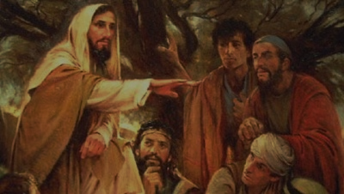
Sermon on the Mount
Matthew 5-7
“Hypocrisy In Giving”

Slide 3
Sermon
on
the Mount
Matthew 6:1-4
Conduct Of Christians In Giving
2 Corinthians 8:-4 “according to their ability…beyond their ability”
Romans 12:8 “he who gives, with liberality”
2 Corinthians 9:7 “God loves a cheerful giver”
GIVING GENEROUSLY

Slide 4
Sermon
on
the Mount
Matthew 6:1-4
JESUS ELEVATED 3 CONCEPTS OF A CHRISTIAN’S CHARACTER:
SPIRITUAL THINKING – NOT TIED TO PHYSICAL WORLD
BREAKING OUR YOKE OF BONDAGE TO THE WORLD ITSELF- 1 JOHN 2:15-17
RIGHT RELATIONSHIPS OF GOODNESS TO OTHER- MARK 9:50

Slide 5
Sermon
on
the Mount
Matthew 6:1-4
THE MOTIVE AND HEART BEHIND OUR GIVING
  “TAKE HEED” (Matthew 6:1a) “ do not do your charitable deeds before men, to be seen by them”
  What Urgency do we understand by this expression?
  Warning Concerning Our Vulnerability
  Matthew 16:6; 24:4; Luke 12:15; 21:8
  “to hold the mind on a matter, take pains, take heed”
  Great care taken so something good does not turn into something evil

Slide 6
Sermon
on
the Mount
Matthew 6:1-4
DON’T BLOW THE TRUMPET (Matthew 6:1,2)
  “Alms” from a word meaning “merciful”
  Practice of the Pharisees – Matthew 23:5-7,14
  Our Giving is for the good it does, and not to serve our own purposes
  Matthew 5:16 “see your good works and glorify your Father in heaven
  Don’t let it be out of a selfish spirit!

Slide 7
Sermon
on
the Mount
Matthew 6:1-4
GIVE IN SECRET (Matthew 6:3,4a)
  Secret and noiseless giving
  Not advocating total secrecy – Mark 12:43-44
  “cast into the treasury” = Public
  Paul “boasts” of the liberality of the Macedonians- 2 Corinthians 8:1-5
  Don’t allow yourself to give from impure motives
  Ananias & Sapphira – Acts 5 GAVE – LIED –Seemed to want to be observed as benevolent as others!

Slide 8
Sermon
on
the Mount
Matthew 6:1-4
WE MUST CONCERN OURSELVES ONLY WITH THE OPPORTUNITY TO HELP – NOT WITH THE SITUATION AS IT MAY BE VIEWED BY OTHERS OR YOURSELF
REWARD IS SURE – Matthew 6:1,4 “reward you”
Matthew 25:34-40 “Come you blessed of My Father”

